Slide 1



FactFinder
Justice League
Introduction
Problem Statement
Persona
Technologies
Team
Agreement
Retrospective
Project
Schedule
Project Description

Slide 2
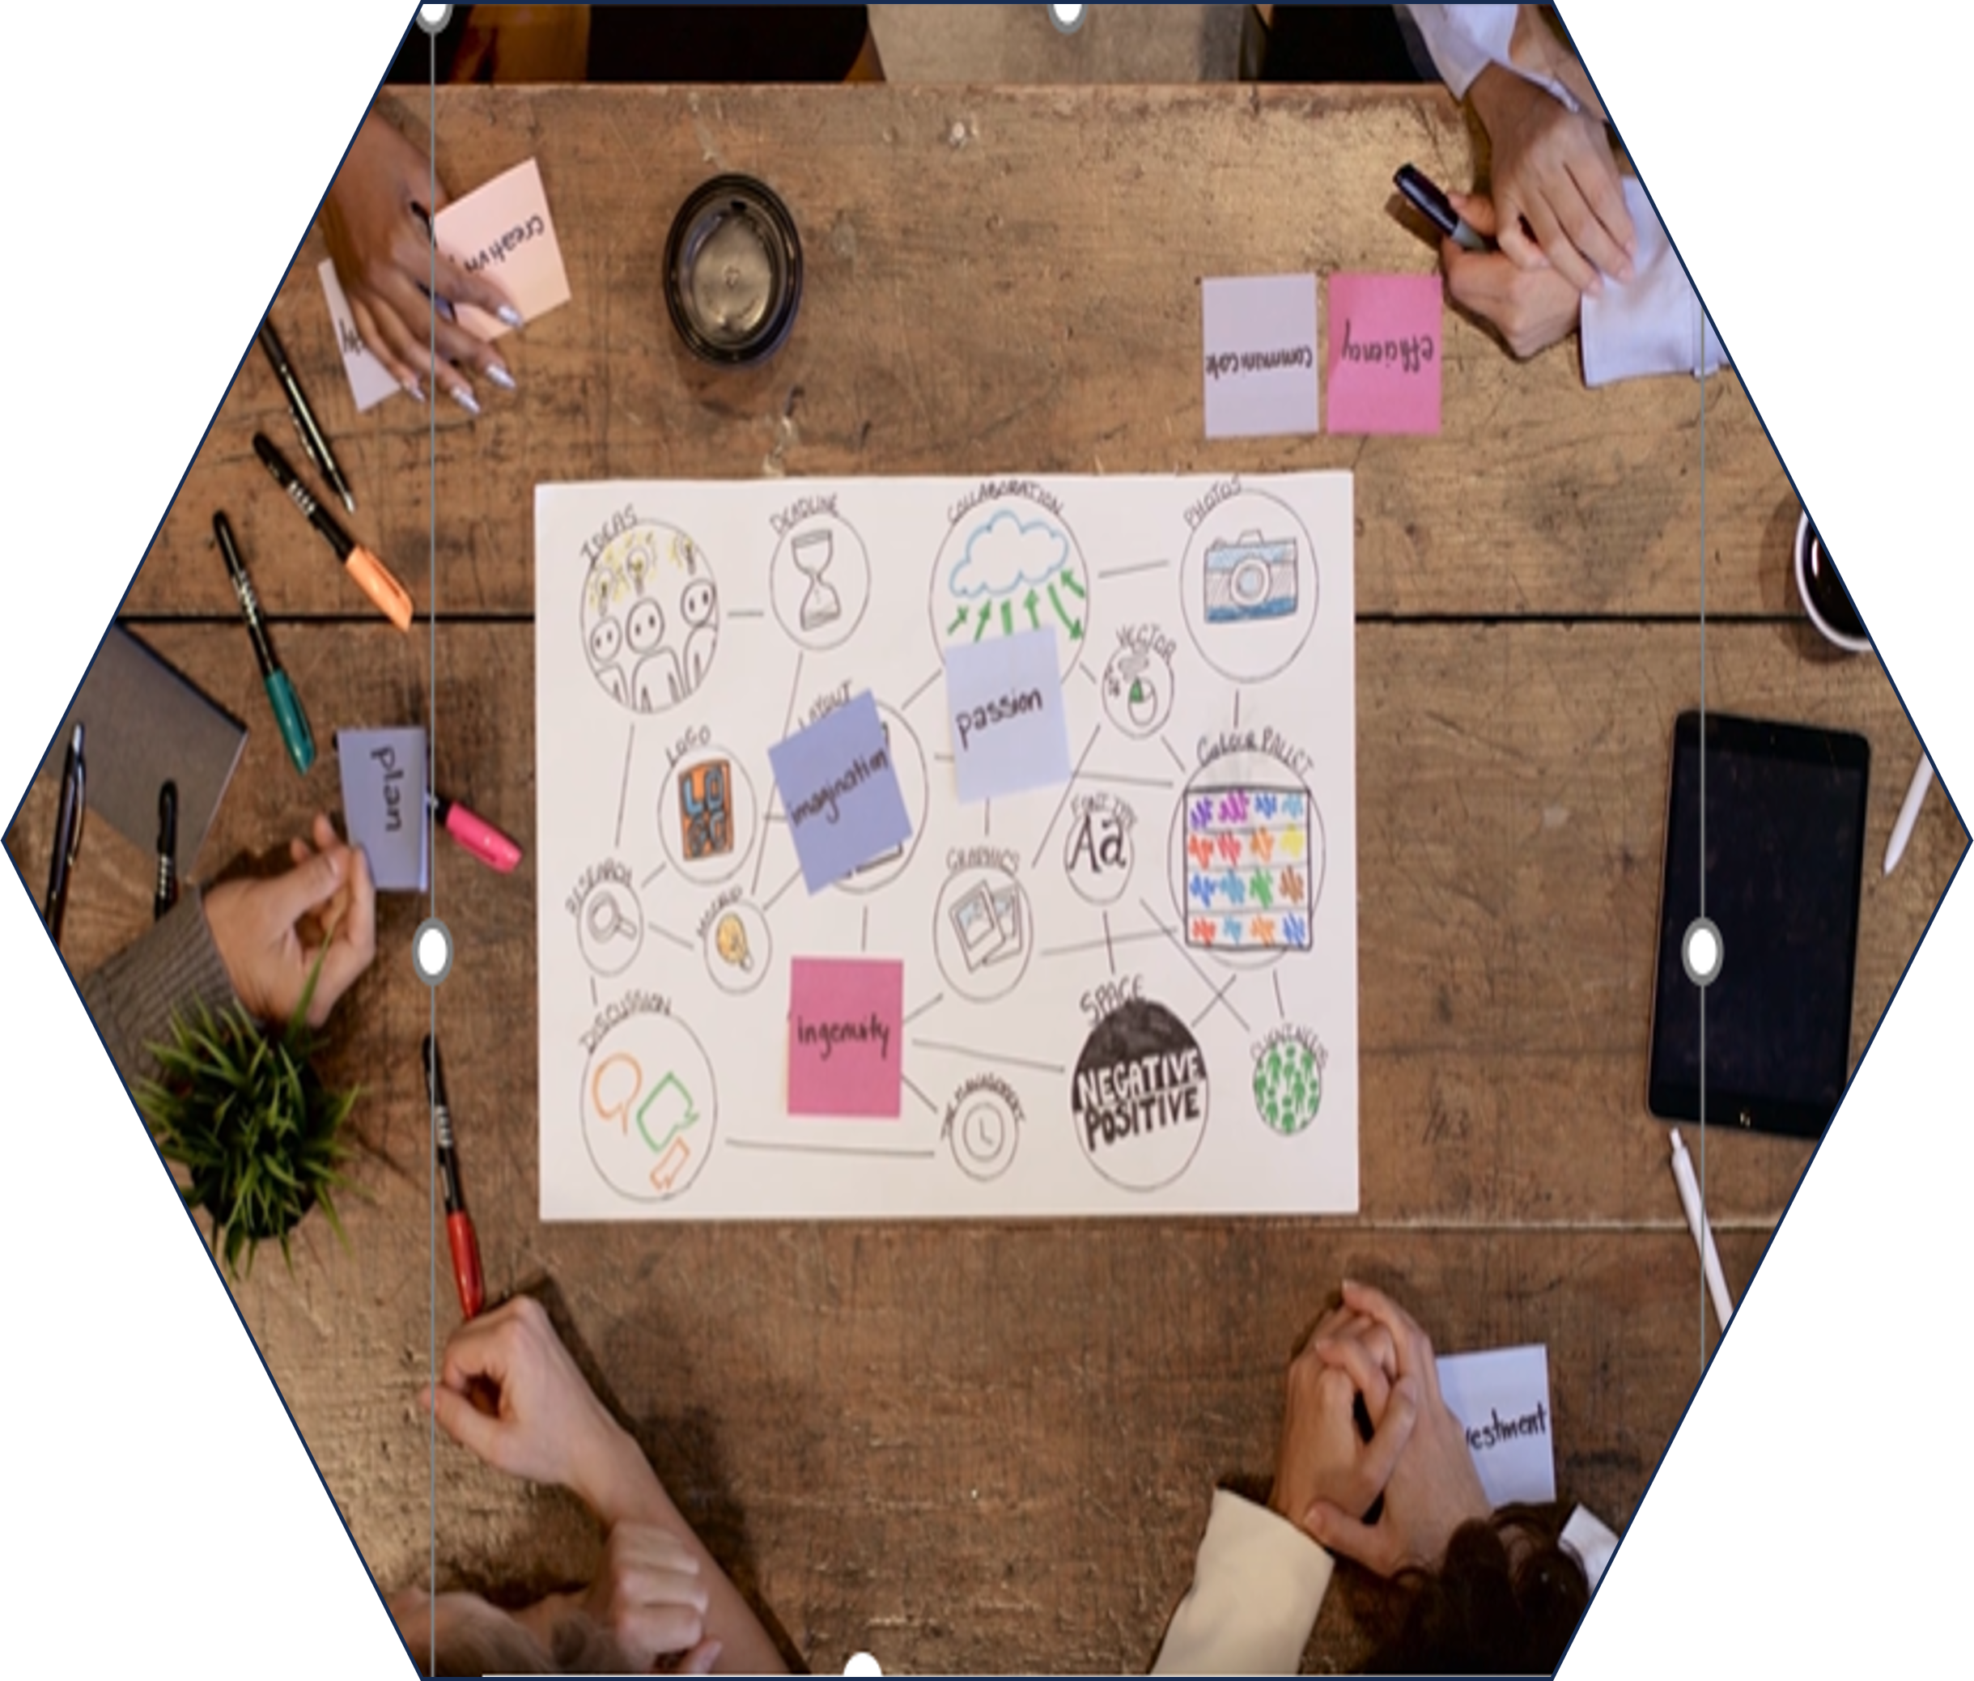
Agenda
Team Introduction
Improvements from professor feed back
Minimum Viable Product
﻿﻿Architecture diagrams
﻿﻿Sequence diagrams
Sprint 2 Recap
﻿﻿Product Backlog
﻿﻿Sprint 3 Backlog
﻿﻿Metrics
﻿﻿Retrospective
﻿﻿Stories planned for sprint 4
﻿﻿Project demo for sprint 3
﻿﻿Live application demo

Slide 3
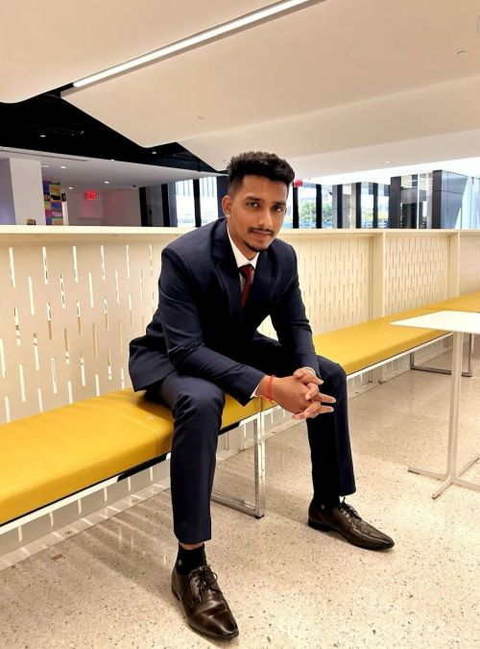


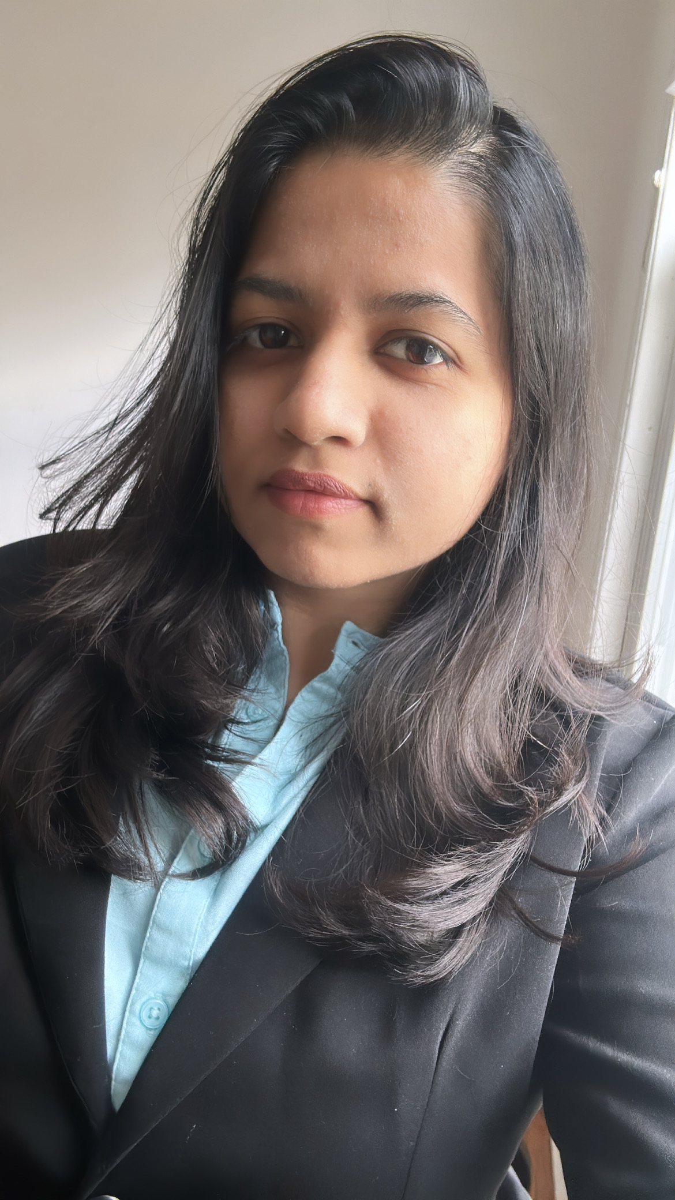



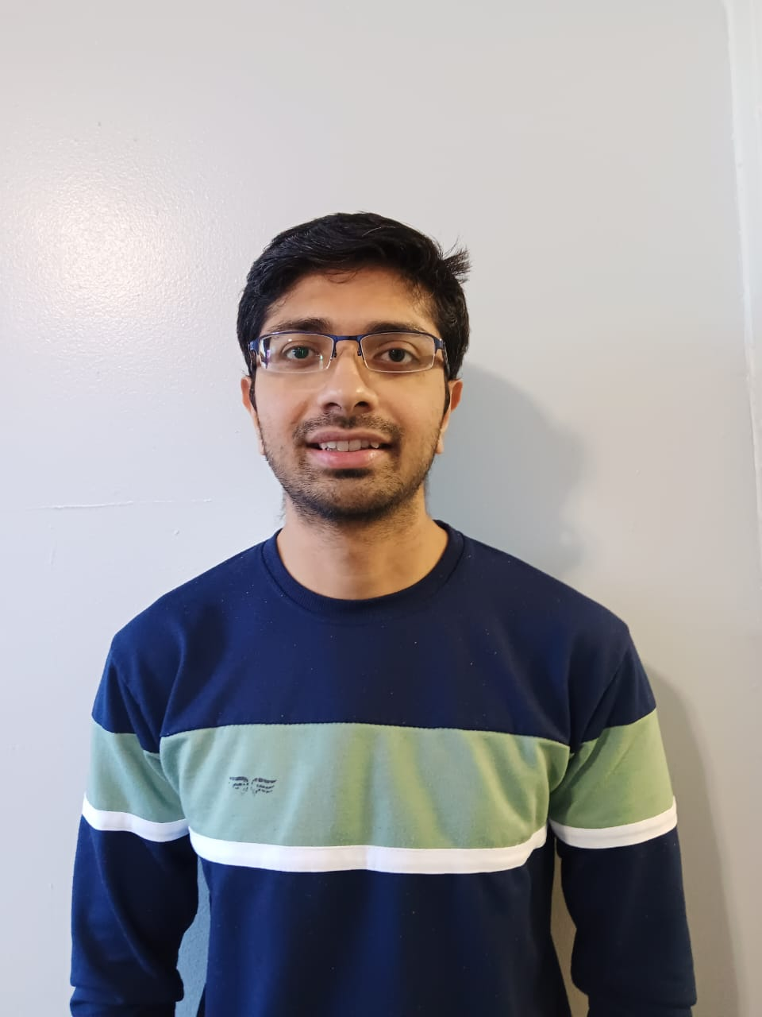
Meet our team
Suraj Salunke
Manthan Kale
Quality Analyst & Developer
Scrum Master & Developer
Kavita Kamtekar
Saurabh Chaudhary
Full Stack Developer
Product Manager & Developer
Gayatri Kulkarni
Maheswari Vidyadharani
Developer
Developer
Sai Kumar Tata
Rushabh Shingala
Developer & Desigining
Developer & Desigining

Slide 4
Improvements made from Professor Feedback
1. Followed the order of slides as per checklist
2. Updated User stories for product backlog
3. Improved Metrices slide
4. Improved Live application demo

Slide 5
Project Description
Fact Finder is a web app designed to combat online misinformation by differentiating between fake and real news. Additionally, it can create a summary of the news.
For anyone concerned about online misinformation and facing time constraints for reading news articles.
who upload the news article the Fact Finder web app is a web app that use machine learning and deep learning algorithms that can detect misinformation.
Unlike believe any information on internet.
Our application verifies the authenticity of information and saves time by creating summaries of articles.
Benefit Outcomes:
• Ensuring the authenticity of the information.
• Saves valuable time by generating summaries of the articles.
• Contributes to the fight against misinformation.

Slide 6
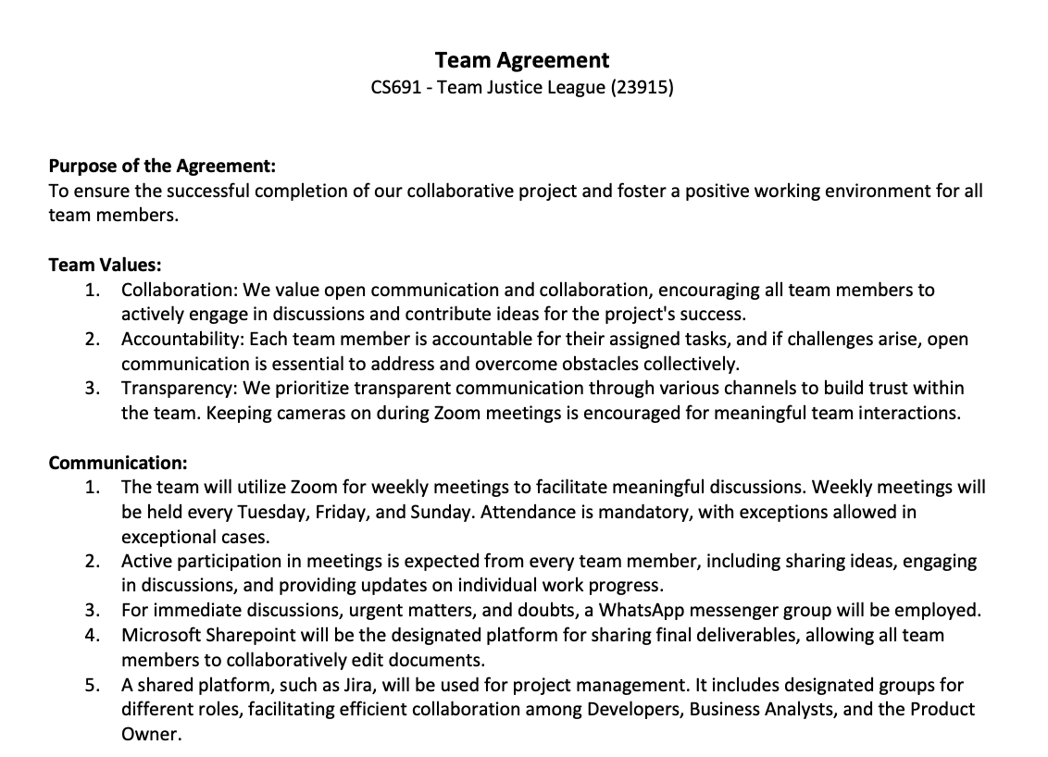
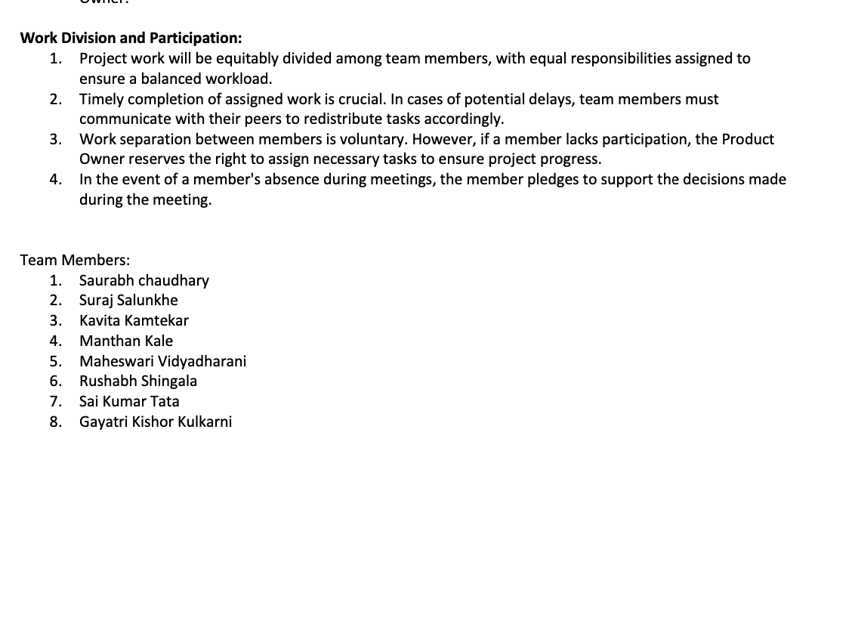
Team working agreement

Slide 7
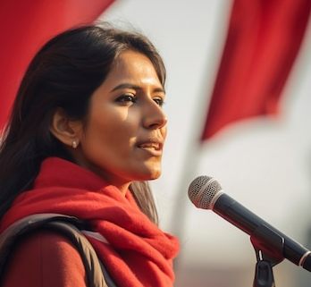
Personas
Background: Maria is a community activist working on social justice issues. She recognizes the role of misinformation in shaping public opinion and wants to combat false narratives that may undermine her advocacy efforts. Maria is motivated to use the web application as a tool to verify information before sharing it within her community.
Age: 35
Occupation: Community Activist
Goals and Motivation: Maria's goal is to empower her community with reliable information. By leveraging the web application, she aims to strengthen the credibility of her advocacy work, foster informed discussions, and counteract misinformation that may be used to undermine social justice causes

Slide 8

Personas
Background: David owns a small business that heavily relies on its online presence for customer engagement. He's concerned about potential misinformation impacting the reputation of his business. The web application is crucial for David to verify news and updates related to his industry.
Age: 38
Occupation: Small Business Owner
Goals and Motivation: David's primary goal is to safeguard his business's reputation. By using the web application, he aims to prevent the spread of false information that could harm customer trust and loyalty. His motivation is to maintain transparency and integrity in his business communications.

Slide 9

Personas
Background: Michelle is a fitness and health enthusiast who frequently relies on online health-related information. With the abundance of health-related news articles and social media posts, Michelle often encounters conflicting information. The web application is valuable for him to discern between credible and misleading health information.
Age: 31
Occupation: Fitness Trainer
Goals and Motivation: Michelle's primary goal is to maintain a healthy lifestyle and share accurate health advice with her followers. By using the web application, he aims to avoid the spread of misinformation in the fitness and health community, contributing to a more informed and health-conscious online environment.

Slide 10
1) The user will also be able to check news without having Account in FactFinder unless user wants to check his search News History. 2) The "Homepage" tab will display a short video of what the Fake news is. 3) The user should navigate to "Verify News" tab and post news as a text in the Textbox. 4) The user will click on verify news button. 5) The system will then generate a response based on our ML model. 6) The user will be able to get a response if the news/text posted was Fake or Real. 7) The "About us" tab will display explanation of the website, what it does and how it works. 8) The user can Register with email-ID and password and user should able to click on submit button to get register successfully. 9) The user should Login with email-ID and password. 10)Users can chat with like-minded people and discuss about any latest news for more information.
MVP(Minimum Valuable Product):

Slide 11





Technologies
1.FrontEnd: JavaScript, HTML5, CSS.
2.Framework: React, Flask.
3.Backend : Python
4.Database : NoSQL, Firebase

Slide 12
Algorithms
Machine Learning Algorithms (scikit-Learn)
Logistic Regression : Supervised learning algorithm for classification.
Recurrent Neural Network(RNN): Ideal for Natural Language Processing(NLP) task.

Slide 13
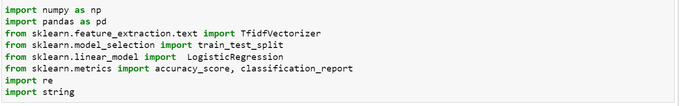
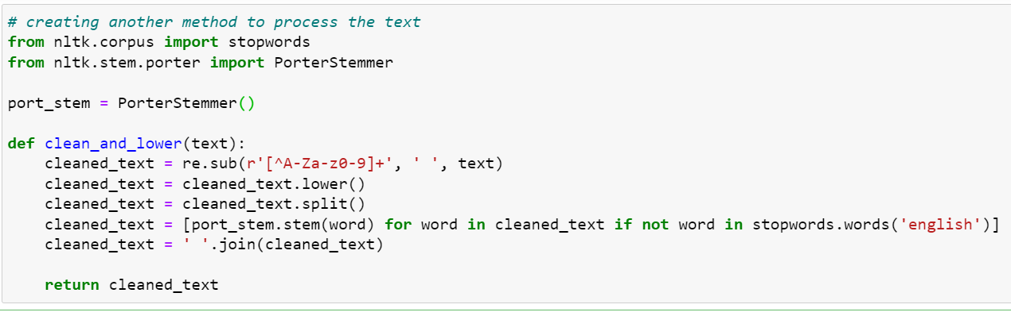
Algorithms(cont..)

Slide 14
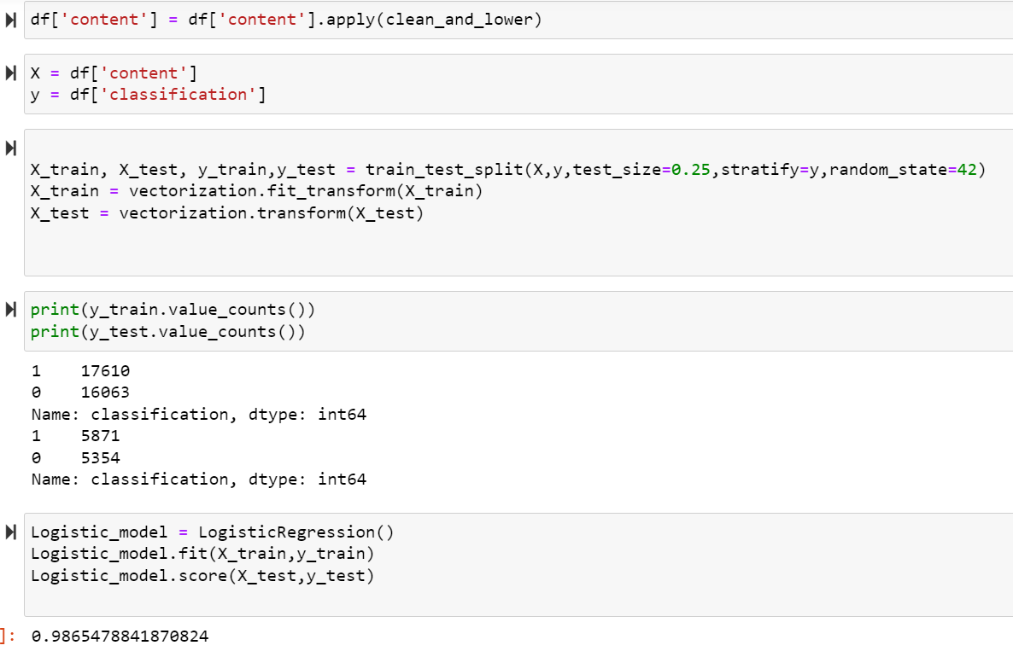
Algorithms(cont..)

Slide 15
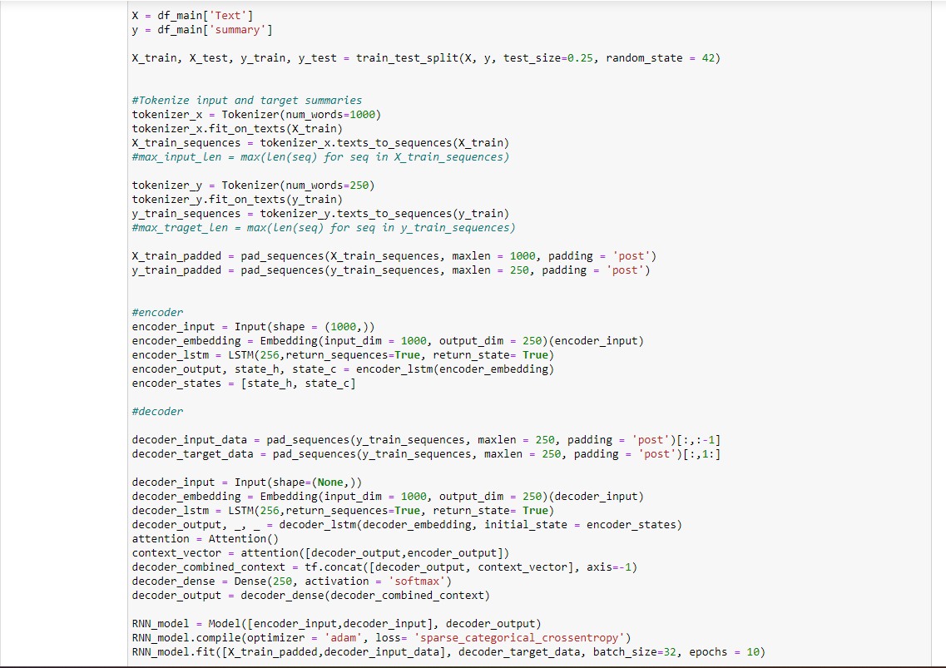
Algorithms(cont..)

Slide 16
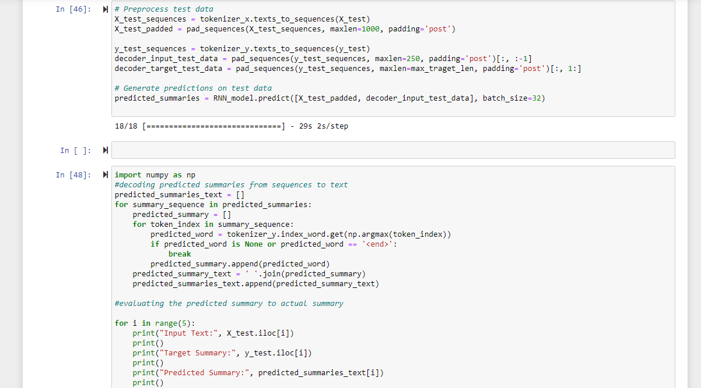
Algorithms(cont..)

Slide 17
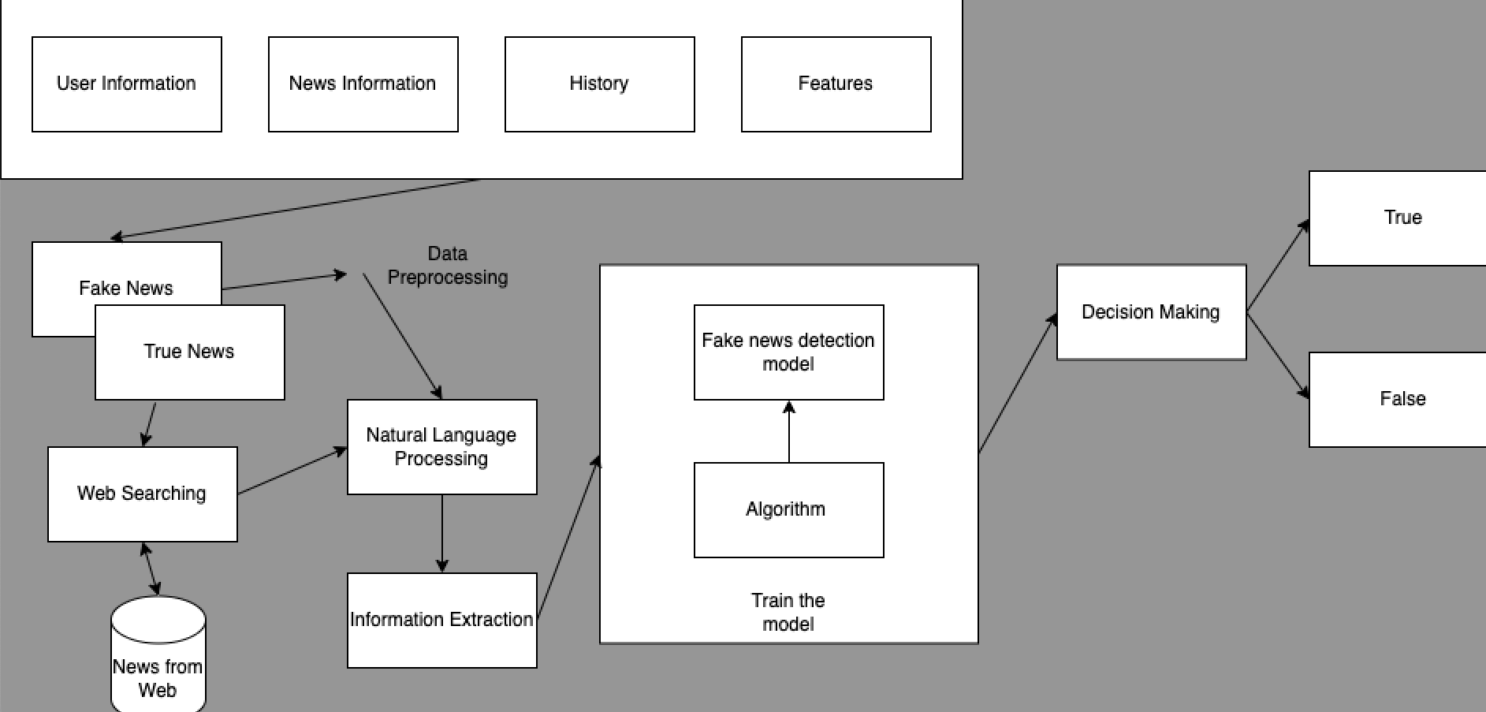
Architecture Diagram

Slide 18
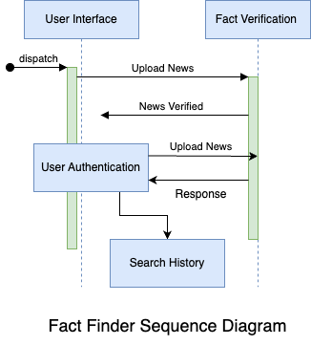
Sequence Diagram

Slide 19
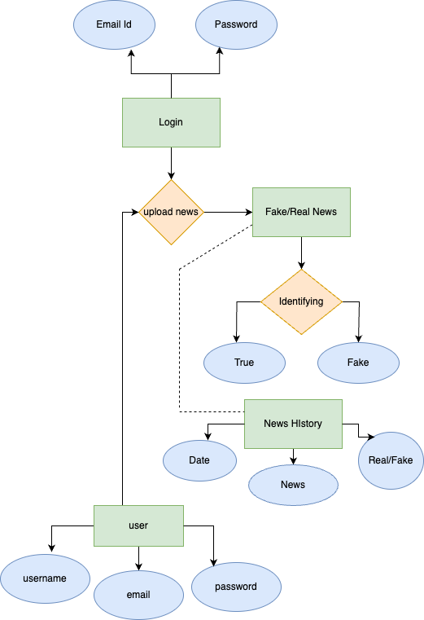
Entity-Relation Diagram:

Slide 20
Sprint 2 Recap
Developed ML model.
Created UI Design (Login and Home page, Search Textbar).
Created Architecture, ER and Sequence Diagram.
Created backend to train ML model.
Tested Backend and frontend functionality.

Slide 21
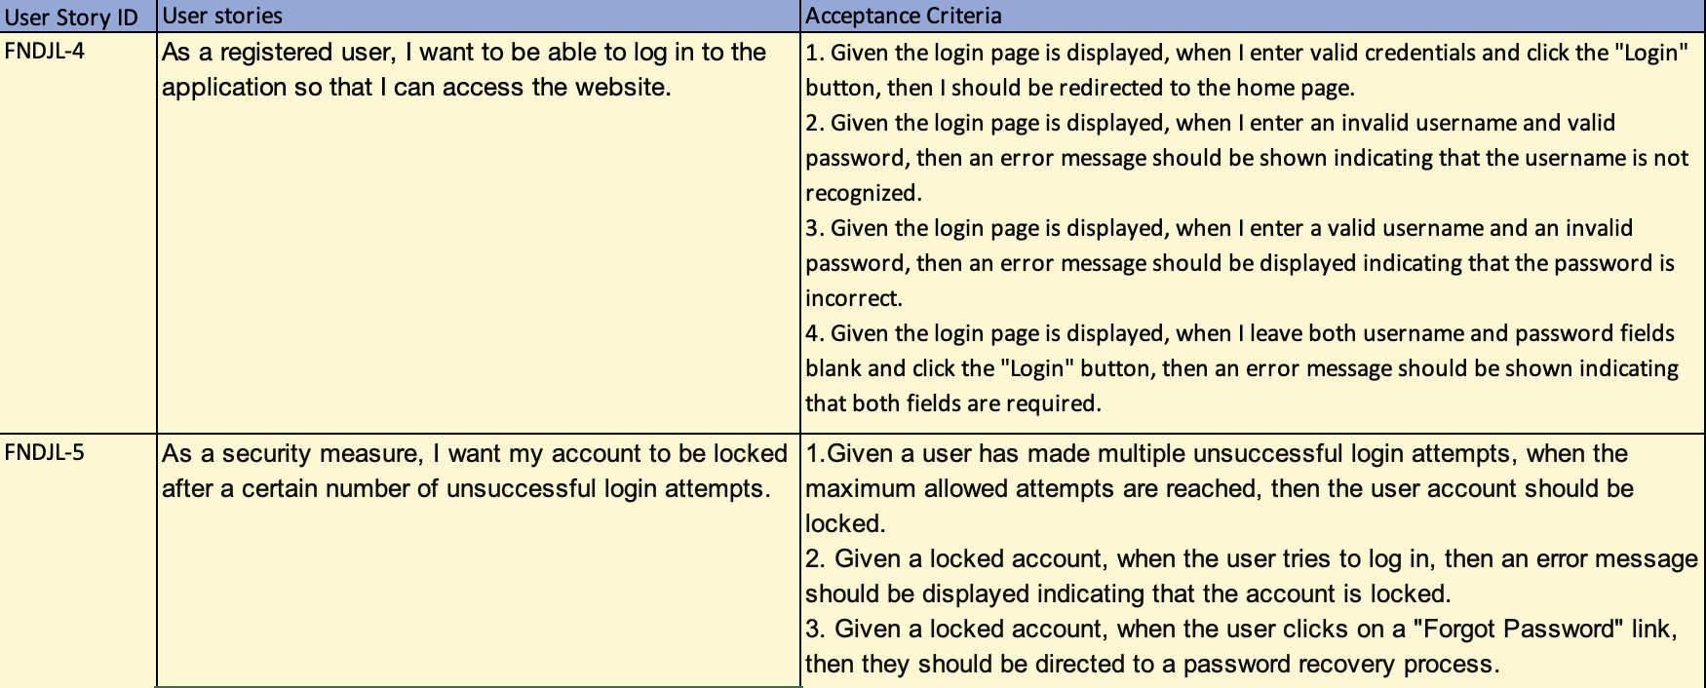
Product Backlog Sprint 2

Slide 22
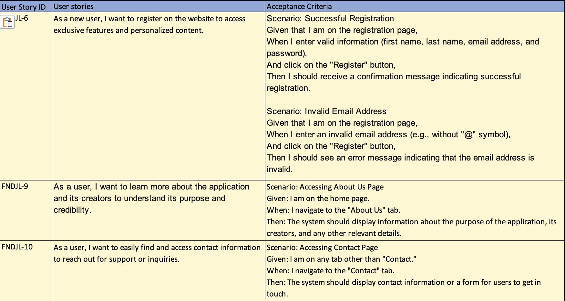
Product Backlog Sprint 2

Slide 23
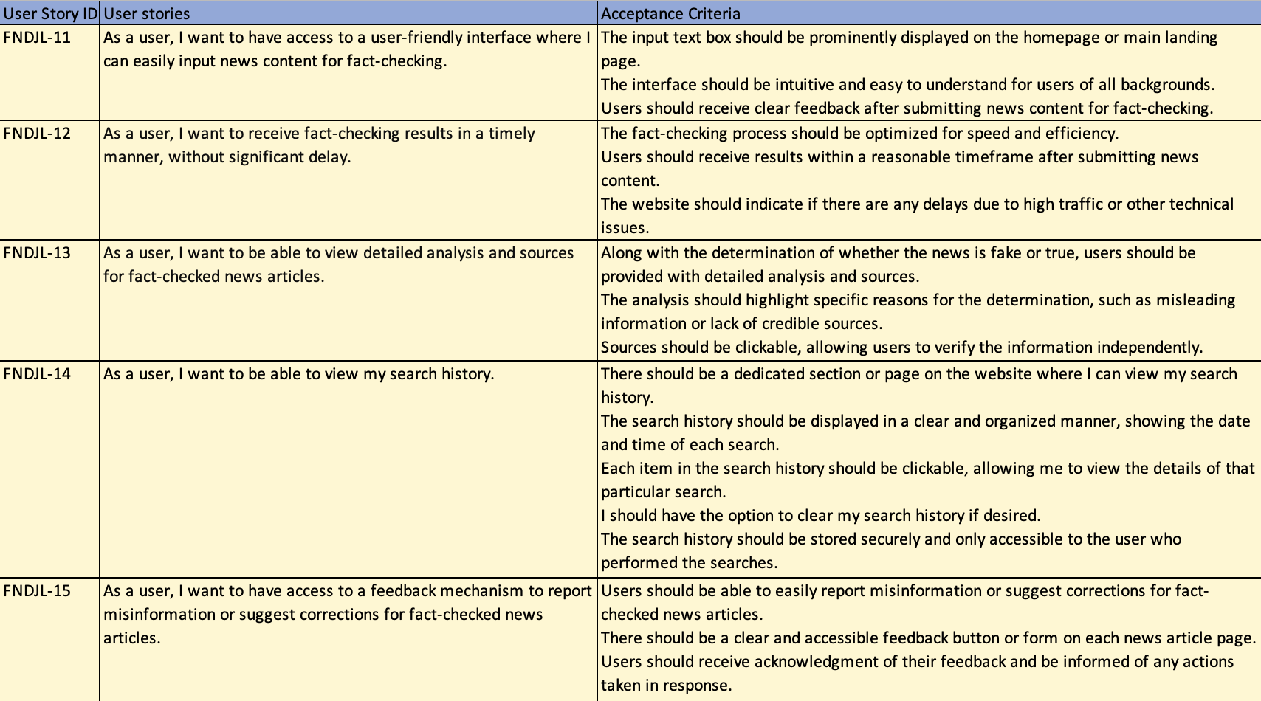
Product Backlog Sprint 3

Slide 24
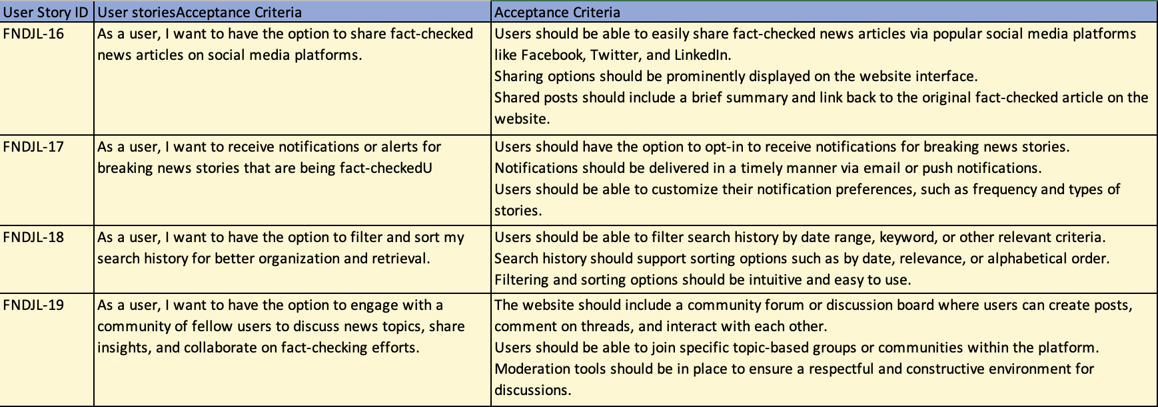
Product Backlog Sprint 4

Slide 25
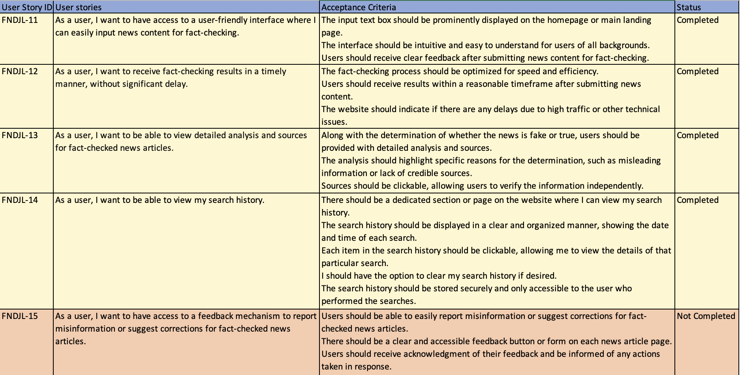
Sprint 3 backlog

Slide 26
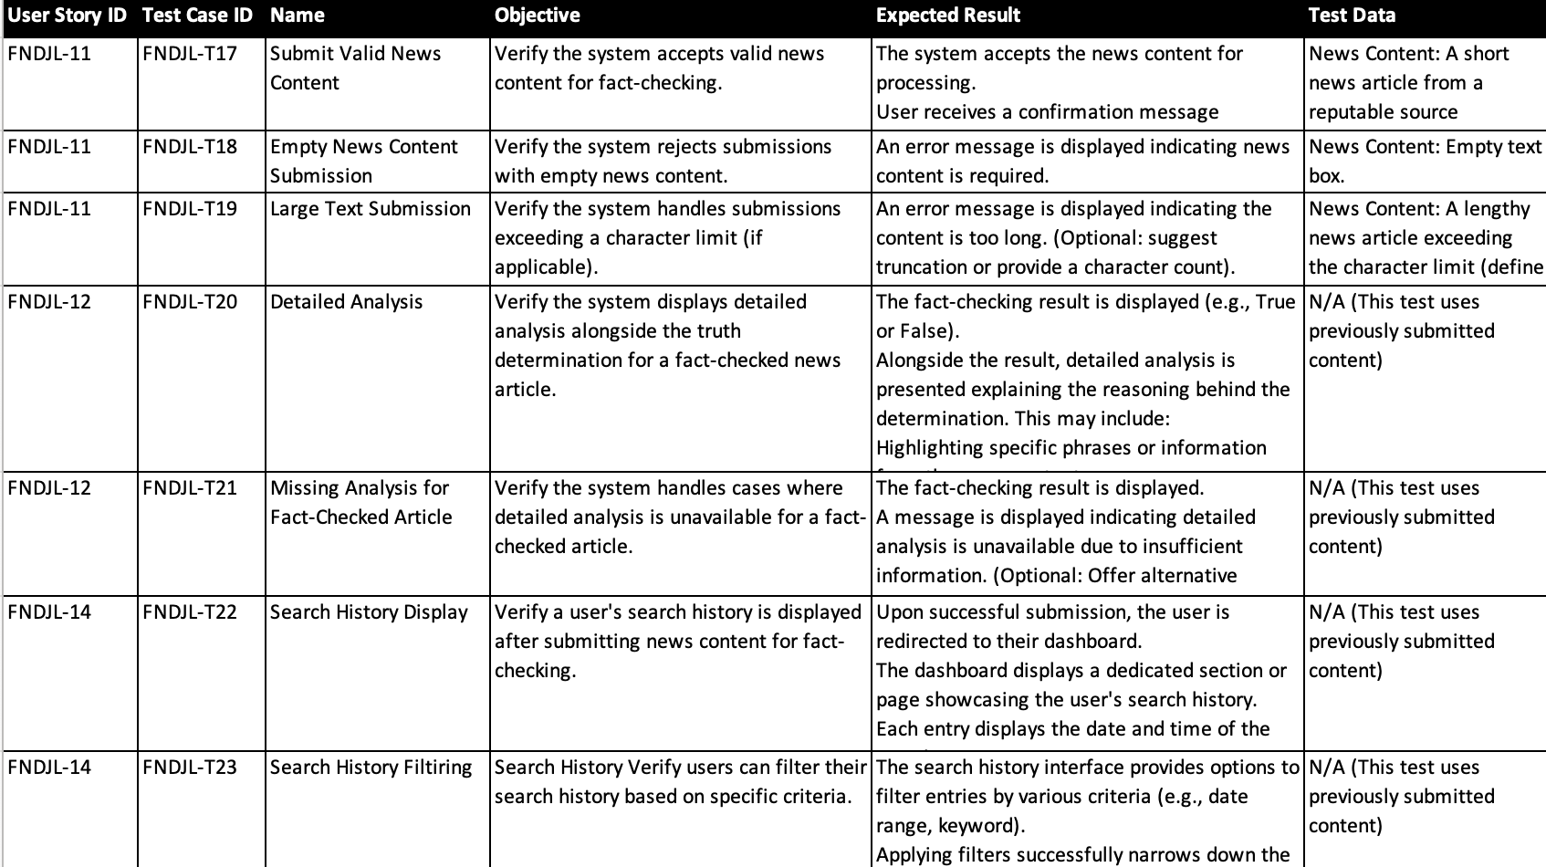
Test Cases

Slide 27

Metrics

Slide 28
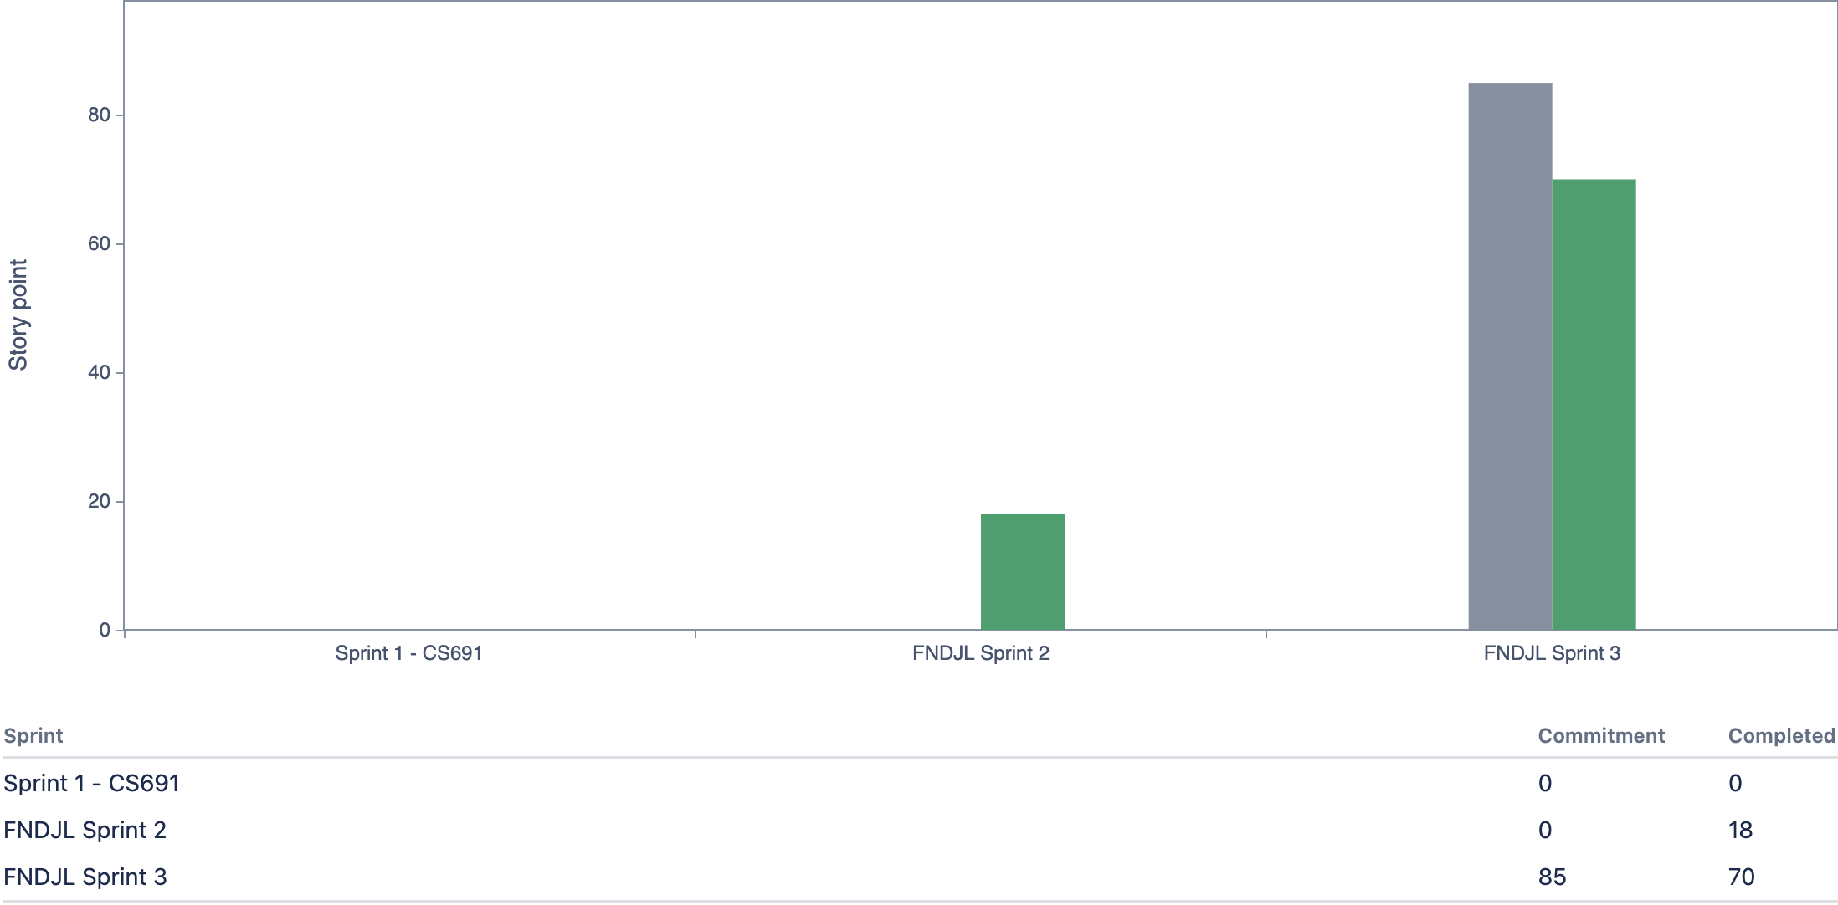
Team Velocity
Completed/Commited Ratio : 82.35 %

Slide 29
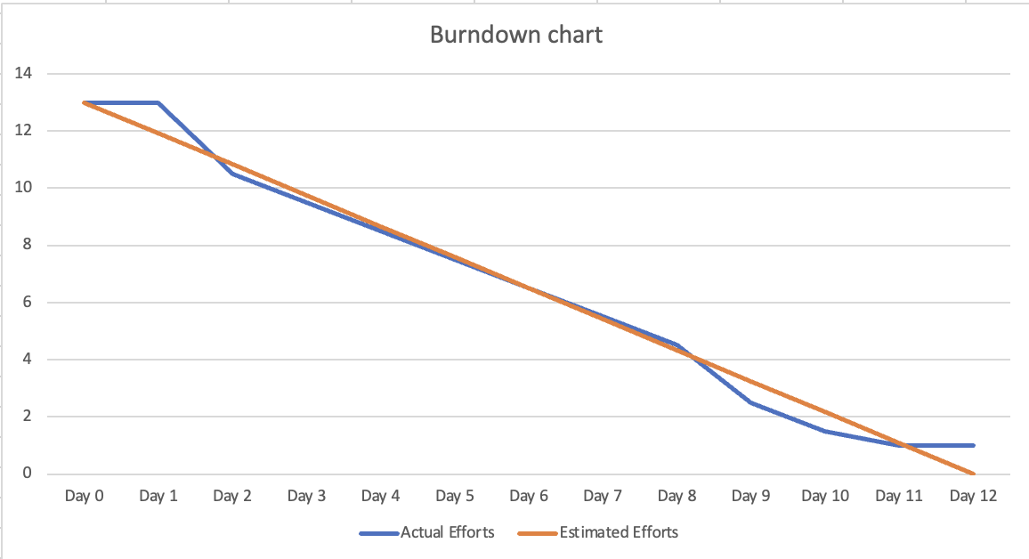
Sprint 2 Burndown Chart

Slide 30
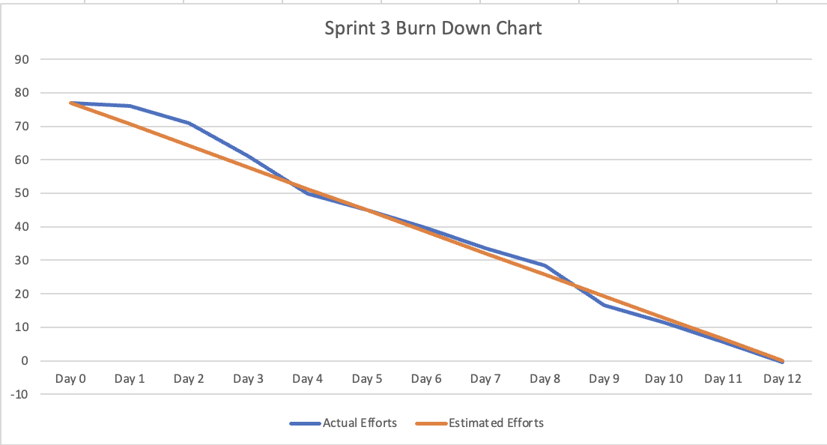
Sprint 3 Burndown Chart

Slide 31
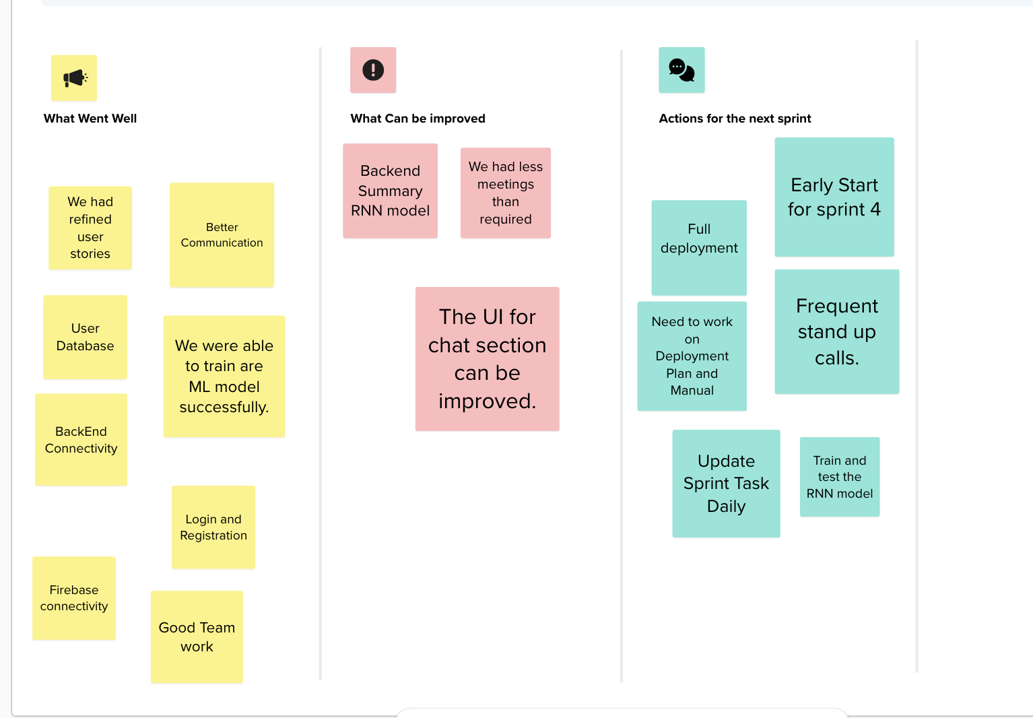
Retrospective

Slide 32
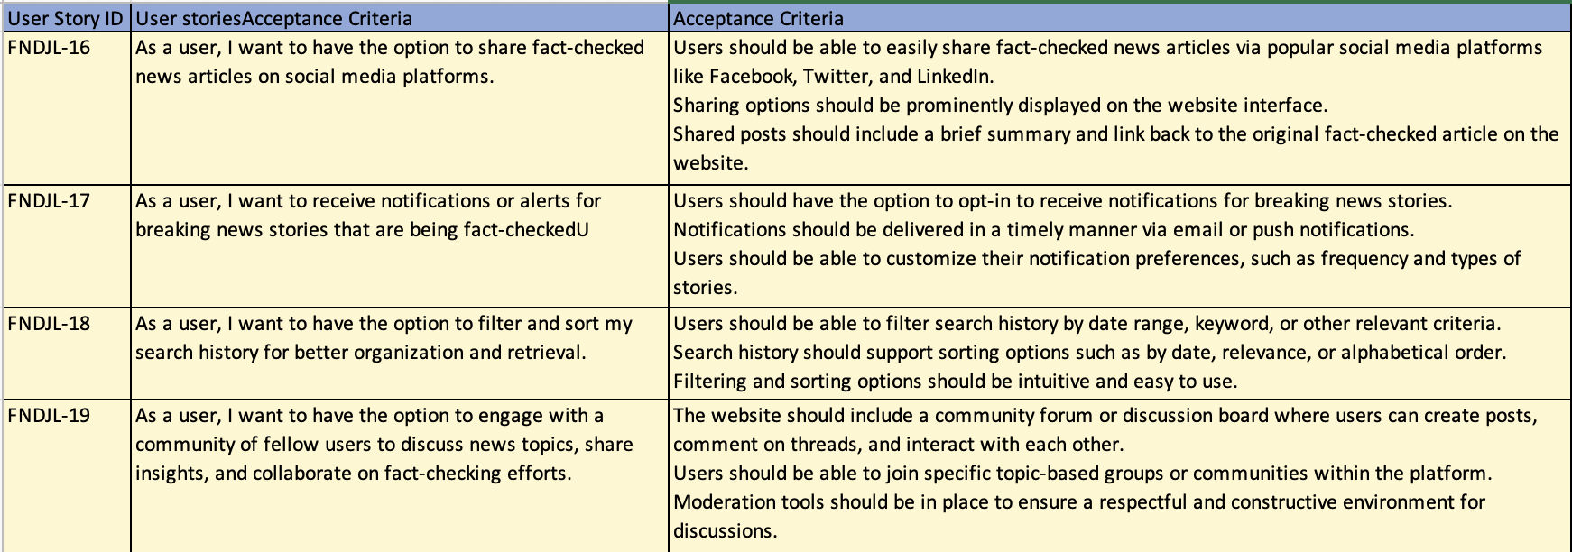
Stories and Acceptance criteria for Sprint 4

Slide 33
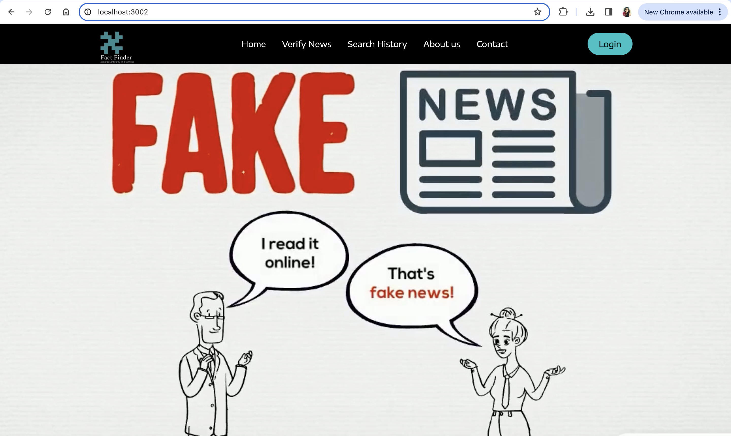
FactFinder website screenshots:

Slide 34
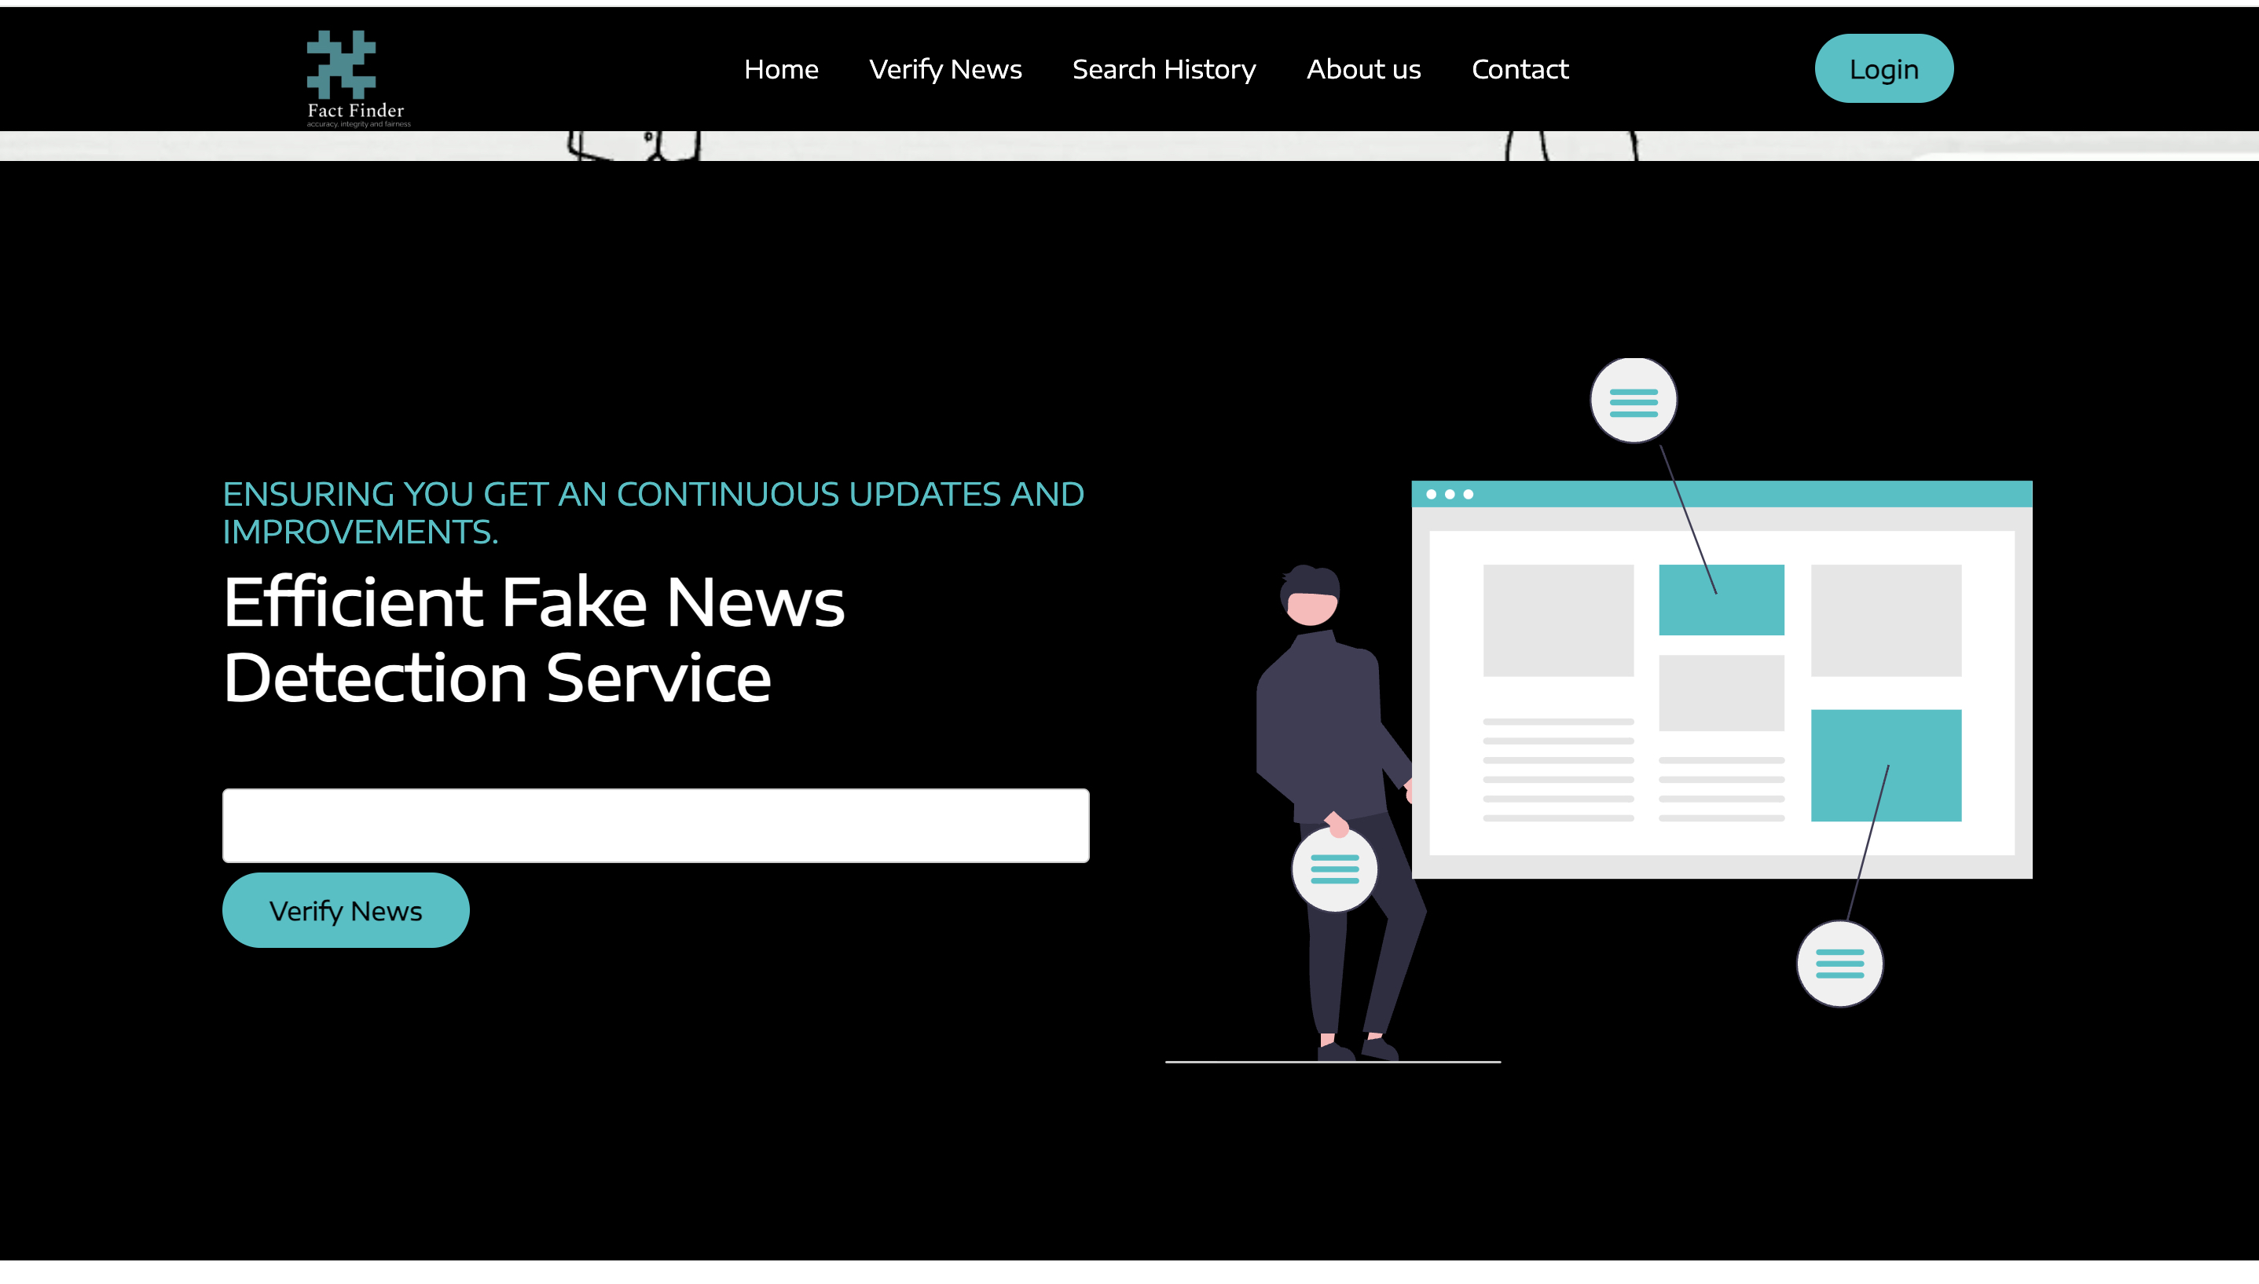
FactFinder website screenshots:

Slide 35
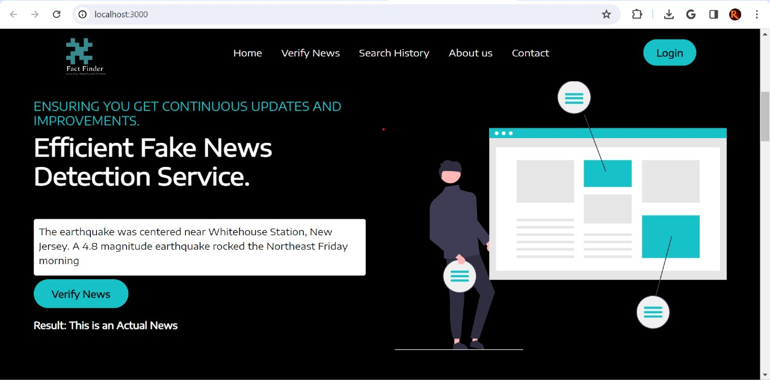
FactFinder website screenshots:

Slide 36
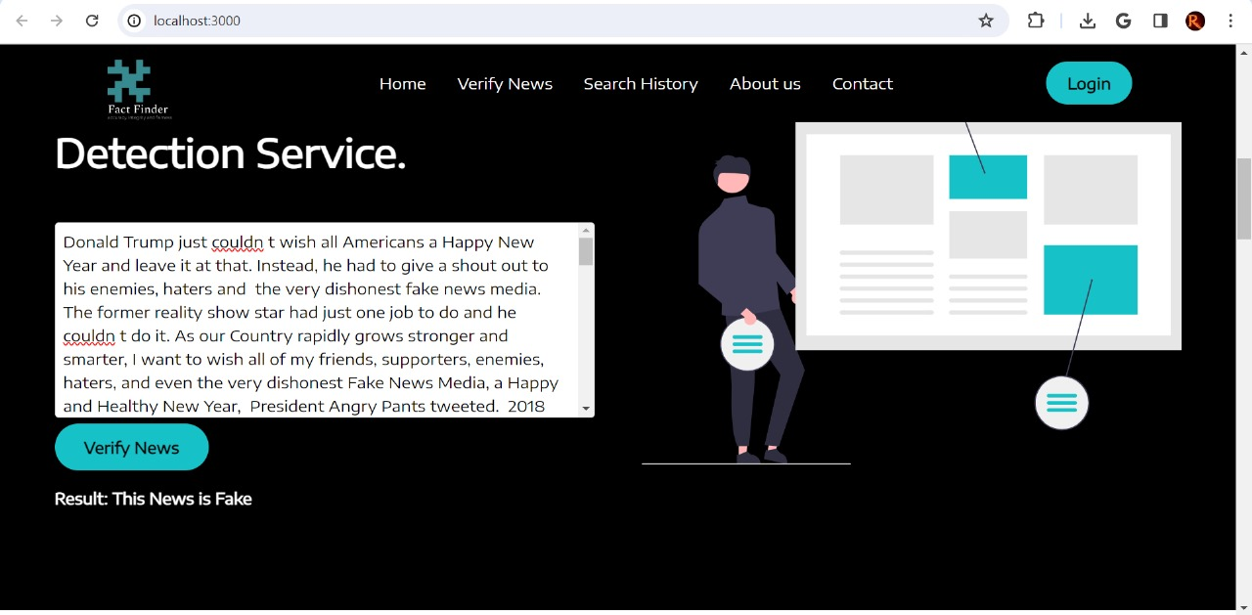
FactFinder website screenshots:

Slide 37
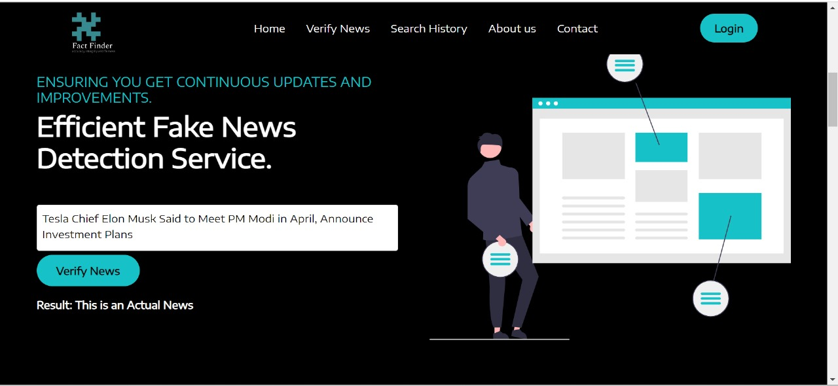
FactFinder website screenshots:

Slide 38
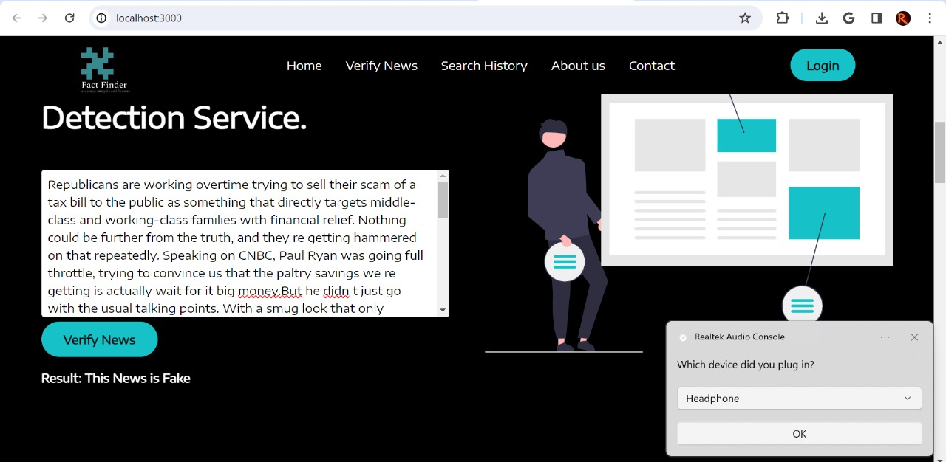
FactFinder website screenshots:

Slide 39
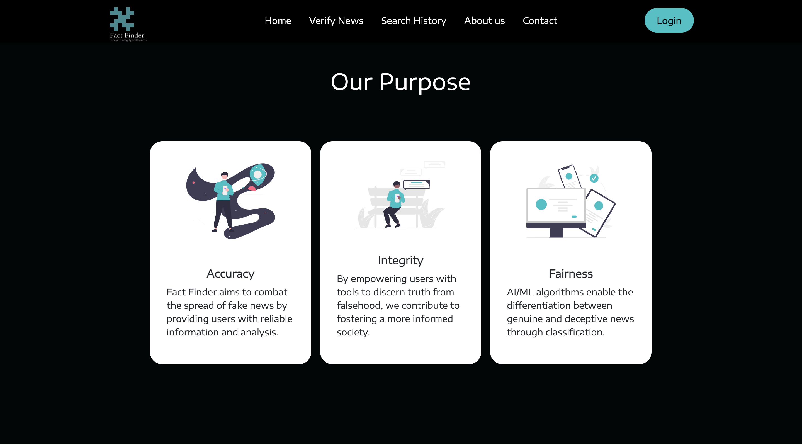
FactFinder website screenshots:

Slide 40
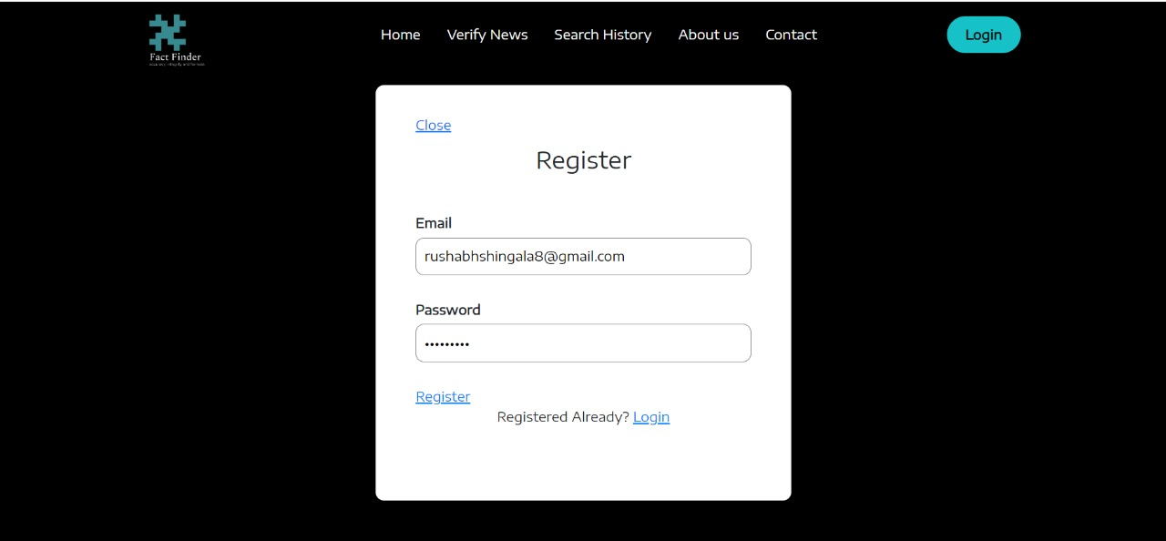
FactFinder website screenshots:

Slide 41

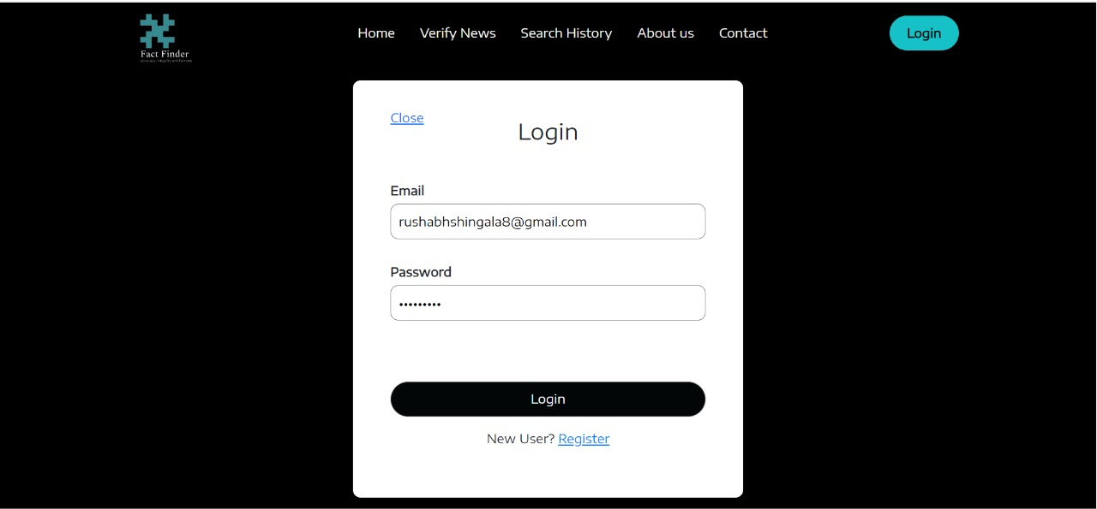
FactFinder website screenshots:

Slide 42
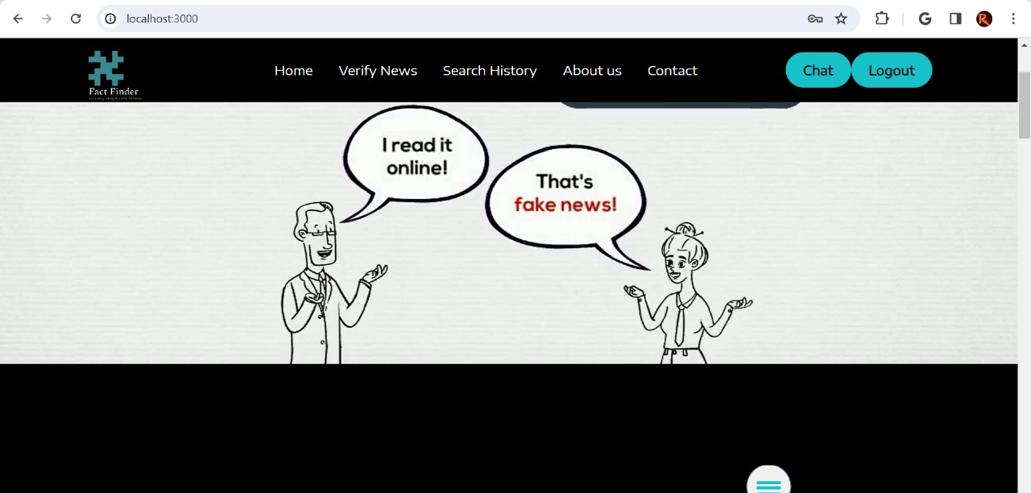
FactFinder website screenshots:

Slide 43
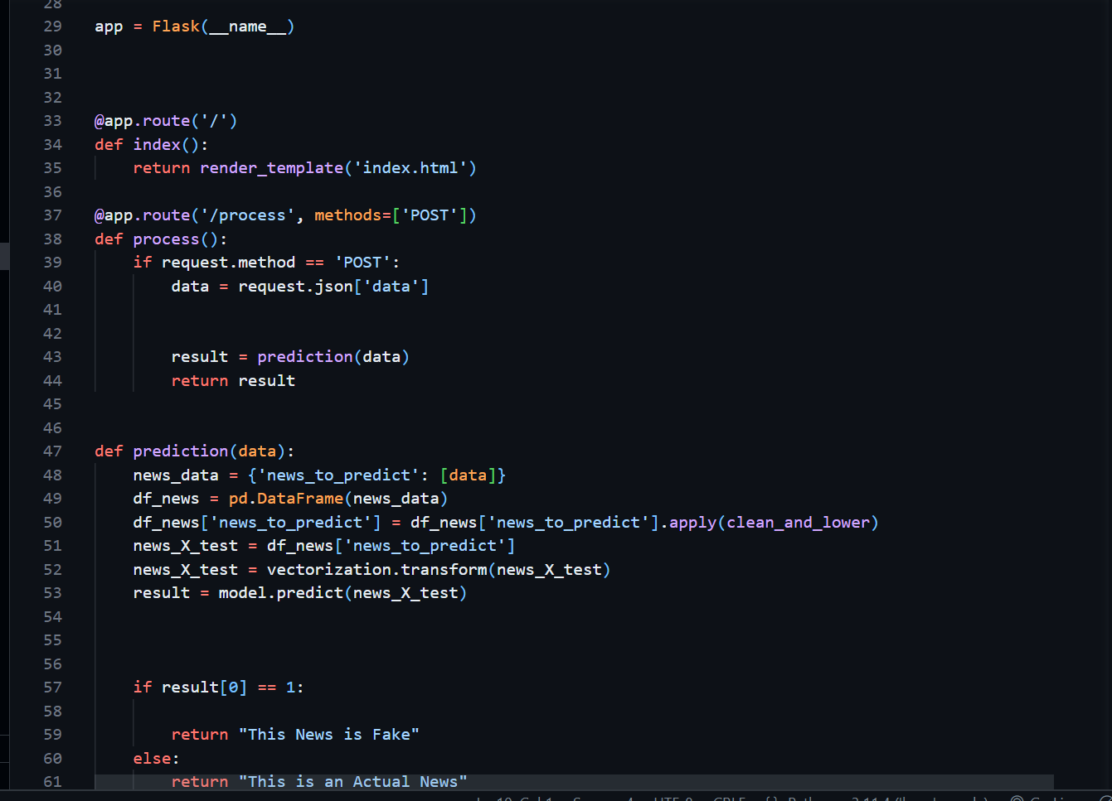
API

Slide 44
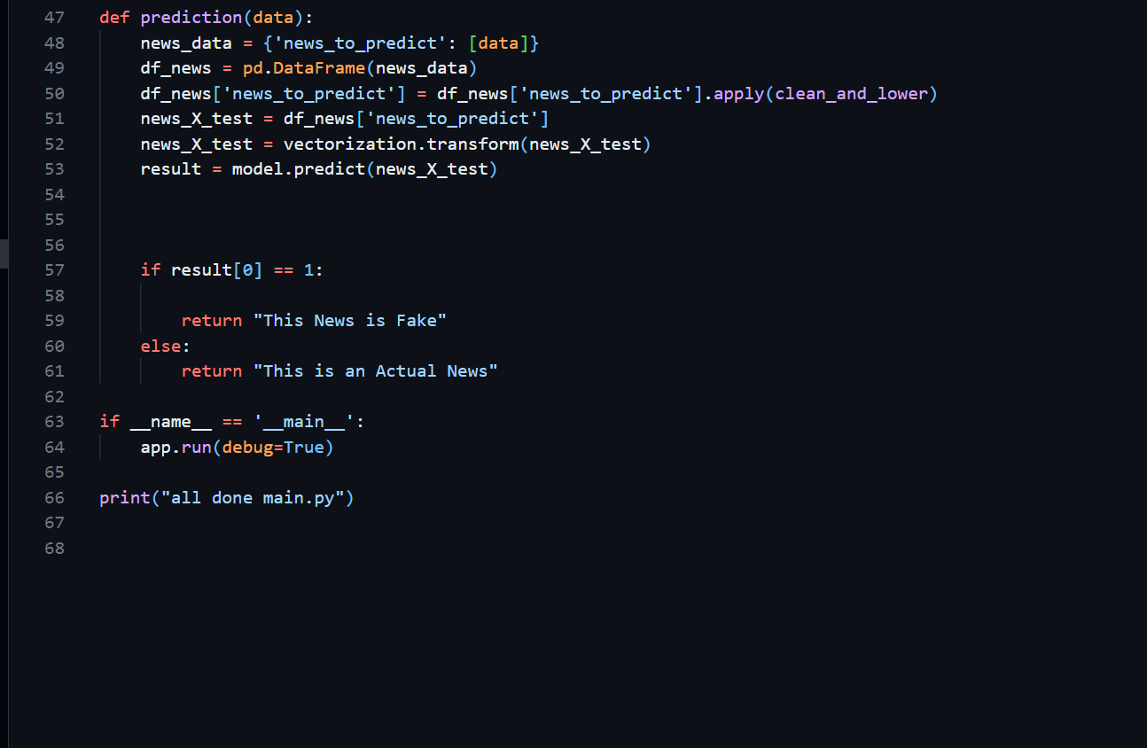
API (Cont..)

Slide 45
Git Hub link:
https://github.com/htmw/2024S-JusticeLeague/wiki

Slide 46
Live Application Demo
Sprint 3 Demo (youtube.com)
https://www.youtube.com/watch?v=HYKTxQoSWUI

Slide 47




Thank you
Team Justice League

